Slide 1

Dorinda Byers
byers.18@osu.edu
Susan Foltz
susan.foltz@development.ohio.gov

Slide 2
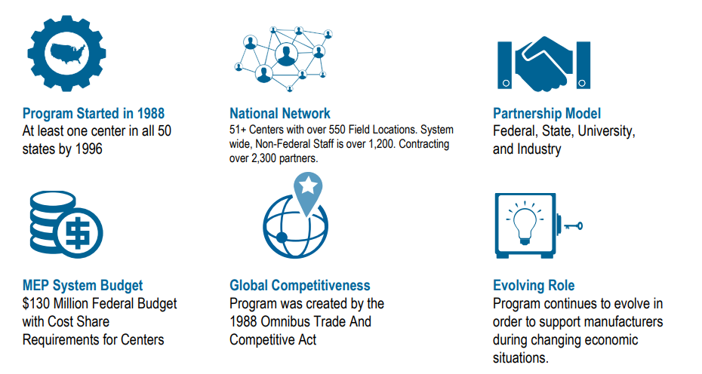
MEP FACTS

Slide 3

WHAT IS MEP?
The nationwide MEP Program is a partnership between the Federal Government and all 50 states and offers a range of resources to help small- and medium-sized manufacturers identify and accelerate growth and competitiveness.
MEP Centers:
Interacted with 26,313 manufacturers
Increased to $12.6 billion in sales
Accumulated $1.7 billion in cost savings
Acquired $3.5 billion in new client investments
Helped create and retain more than 100,000 jobs

Slide 4


WHAT IS MEP?
The Ohio Manufacturing Extension Partnership (MEP) works with manufacturers to help them create and retain jobs, increase profits and save time and money.
Ohio MEP serves as a trusted business advisor, focused on solving challenges and identifying opportunities for growth.
Ohio MEP is part of a statewide and national network driving economic development and measuring results through a third party survey.
The critical areas of services are operational support and quality, workforce, advanced manufacturing, and cybersecurity.

Slide 5


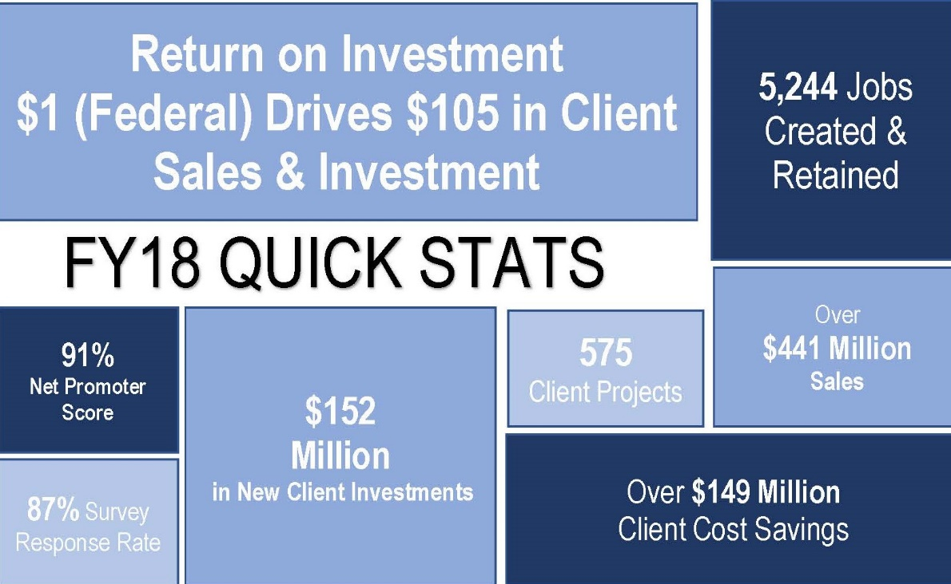





Ohio Manufacturing Extension Partnership (MEP)
https://vimeo.com/261192892
Driving productivity, growth, innovation
and global competitiveness for
Ohio’s manufacturers

Slide 6
HELLO!
My name is…
I work at…
Fun fact about me is…
My biggest team challenge is…

Slide 7

ABSENCE OF TRUST
AVOIDANCE OF ACCOUNTABILITY
FEAR OF CONFLICT
LACK OF COMMITMENT
INATTENTION TO RESULTS

Slide 8

ACTIVITY: TEAMS
Form sub-groups of 2–3 people.
Each person quickly describes a best or worst team experience.
All discuss the qualities that made those teams best or worst.
Use examples from teams other than this one.
Give me 1 word to describe a leader…
Report back to entire group from one person in each sub-group

Slide 9
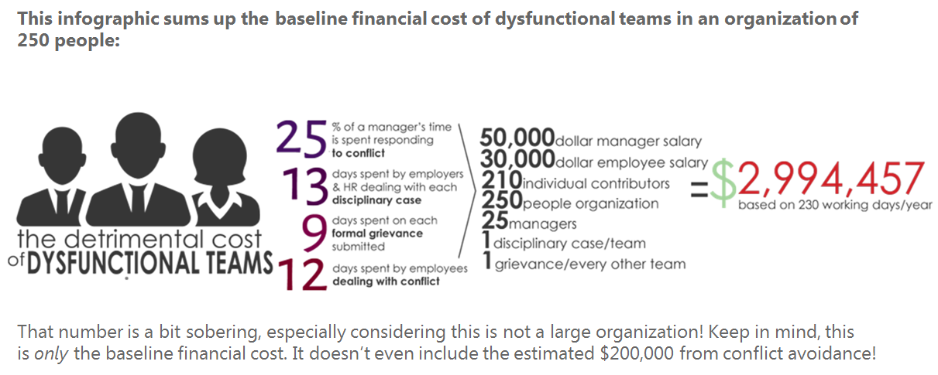
COST OF DYSFUNCTIONAL TEAMS
*Data provided by CIPD Research & Stamford Global

Slide 10
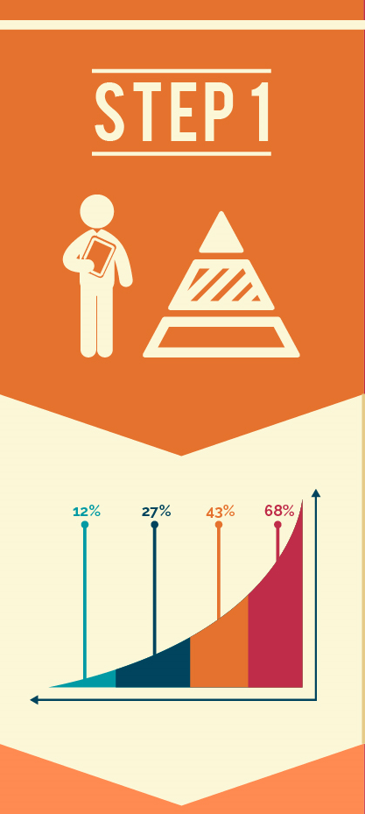
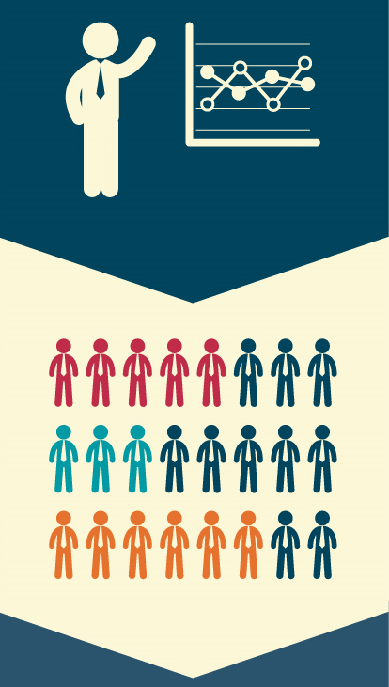

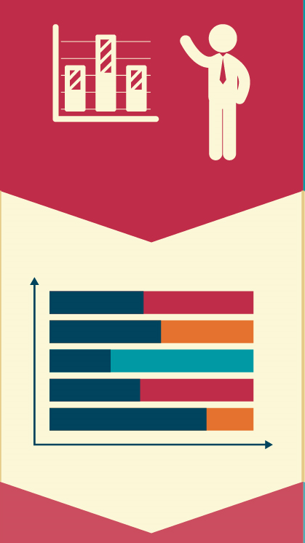
PRODUCTIVITY STATISTICS
Productivity is increasing, overall, by 2.9 percent
People consistently overestimate their own productivity by 11 percent
The average worker receives 121 emails per day
86 percent of executives cite ineffective communication as a major source of productivity failures
Productivity plummets after 50 hours a week
Businesses spend more than 17 hours a week clarifying communication
Connected employees give organizations a 20-25 percent productivity increase
An engaged workforce leads to 202 percent higher cumulative performance
70 percent of workers are disengaged
The most productive employees have 10 years of experience in the company
Happy workers are 12 percent more productive
The most productive employees represent 5 percent of the workforce
Stress impact on productivity ($600 per employee, per year)
Job satisfaction boosts productivity by 6.6 percent
Up to 67 percent of meetings are failures
58 percent of employees cite management as the biggest hurdle to productivity
75 percent of Americans don’t think they have access to the latest in efficiency tools
Workplace internet misuse costs $63 billion annually
Companies with regular opportunities for employee feedback have much lower turnover
Multitasking makes you 40 percent less productive
People who telecommute are more productive (by 14 percent)
Employees are 68 percent less productive when they feel overloaded

Slide 11
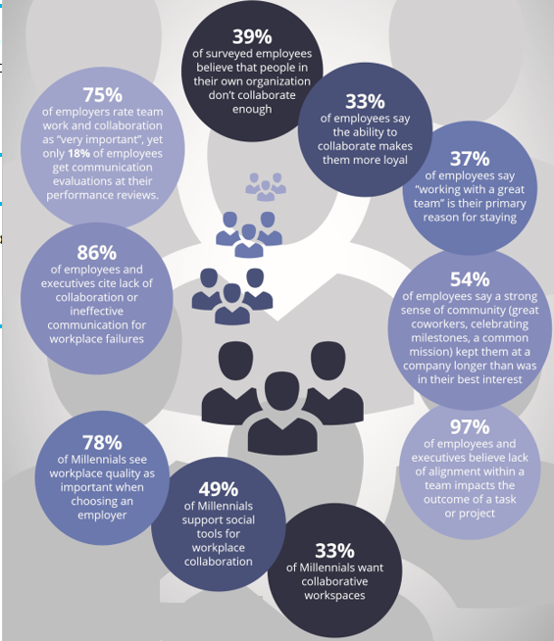

COLLABORATION

Slide 12
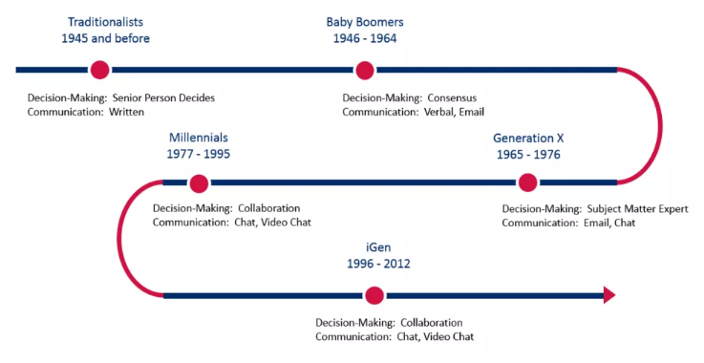
WORKPLACE PREFERENCES OF THE FIVE GENERATIONS
The common values, beliefs, parenting styles and societal norms of each generation have resulted in workplace preferences. Each generation prefers certain leadership styles, decision-making methods, modes of communication, the frequency of feedback, and degrees of transparency. The generational preferences around decision making and modes of communication cause many conflicts in the work environment. Technology has enabled employees to instantly find information and share opinions about anything and everything all the time.

Slide 13
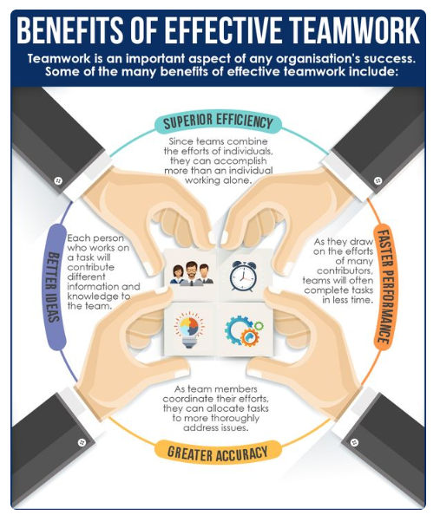
TEAMWORK

Slide 14
IS YOUR TEAM READY FOR THIS PROCESS?
Because the assessment and accompanying material is designed for an intact team, there are a number of issues that can affect the success of your program. Before conducting the assessment and follow-up sessions, consider these questions:
Is the team really a TEAM? Yes____ No_____
A team is a relatively small number of people (from three to twelve) who meet on a regular basis and are collectively responsible for results. The team members share common goals as well as the rewards and responsibilities for achieving them. Not every group is a team. For example, a group that appears to be a team might simply be a collection of people who report to the same manager, but who have relatively little interdependence and mutual accountability. If a group does not meet the criteria of a true team, this process is unlikely to produce the results they expect.
Is this team ready for “heavy lifting”? Yes____ No_____
The advantages of being a highly functioning team are enormous. But they can only be achieved if the team is willing to invest time and energy in the process.
Is the leader truly committed to building a team? Yes____ No_____
The fact is, leadership matters. The key to transformation is a committed leader. For a team to achieve its full potential, the leader must understand the power of teamwork and be prepared to lead the effort in terms of setting an example and dedicating time to it. Still, it’s important to note that many leaders who seem uninterested in teamwork are often just skeptical about the possibility of achieving it or afraid that acknowledging the need for it might reflect poorly on them. In these cases, success is possible as long as team leaders are willing to start the process with good intentions.
Is this the right time? Yes____ No_____
Certain situations make it difficult to effectively implement the feedback process. We suggest that you reconsider conducting the sessions if any of the following situations exist:
The team is very new. A team should have been together for a minimum of six to eight weeks prior to utilizing this assessment. For new teams, it would be better just to introduce the model and discuss the behaviors of a cohesive team.
There is about to be a change in the nature of the team. The time is probably not right if multiple team members are leaving or joining the team or if the team’s responsibilities are about to change significantly. In those situations, it would be better just to give a presentation on the model and then wait to conduct the assessment until the team is stable.
There is going to be or recently has been a significant organizational change, such as a merger or a reorganization.

Slide 15
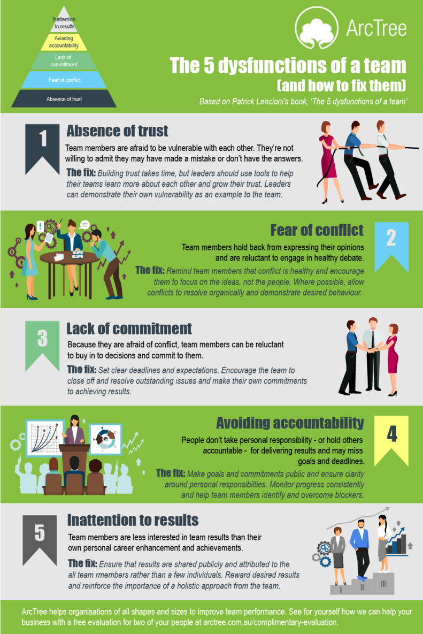
THE 5 DYSFUNCTIONS

Slide 16
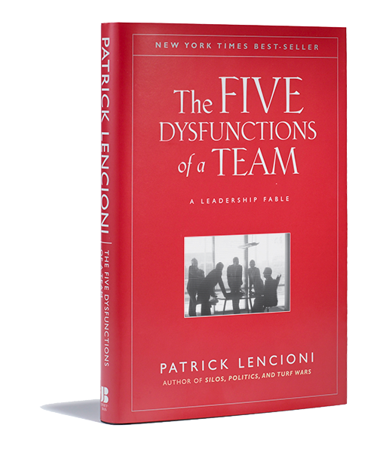
FIVE BEHAVIORS OF A COHESIVE TEAM
The Five Behaviors of a Cohesive Team has a simple goal: To facilitate a learning experience that helps professionals and their organizations discover what it takes to build a truly cohesive and effective team.
The Five Behaviors profile, which provides both individual and team feedback, is grounded in the model described in The Five Dysfunctions of a Team, the internationally best-selling leadership fable by Patrick Lencioni. With this program, participants will learn how, as a team, they score on the key components of the model: trust, conflict, commitment, accountability, and results.
Additionally, the program is powered by Everything DiSC a model that helps individuals to understand themselves and others better. Using these results, participants will be able to create a better, stronger team.
“Not finance. Not strategy. Not technology. It is teamwork that remains the ultimate competitive advantage, both because it is so powerful and so rare.”
Patrick Lencioni

Slide 17
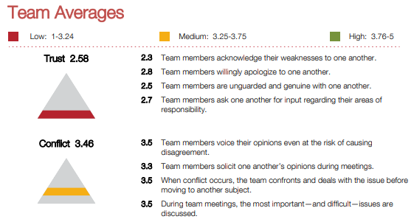
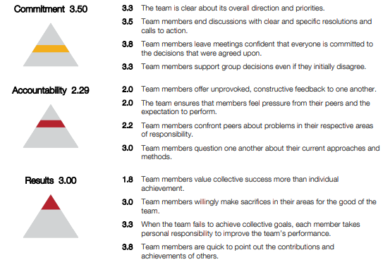
SAMPLE REPORT

Slide 18
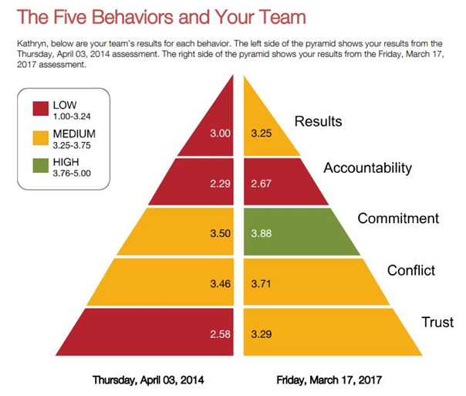
SAMPLE REPORT

Slide 19
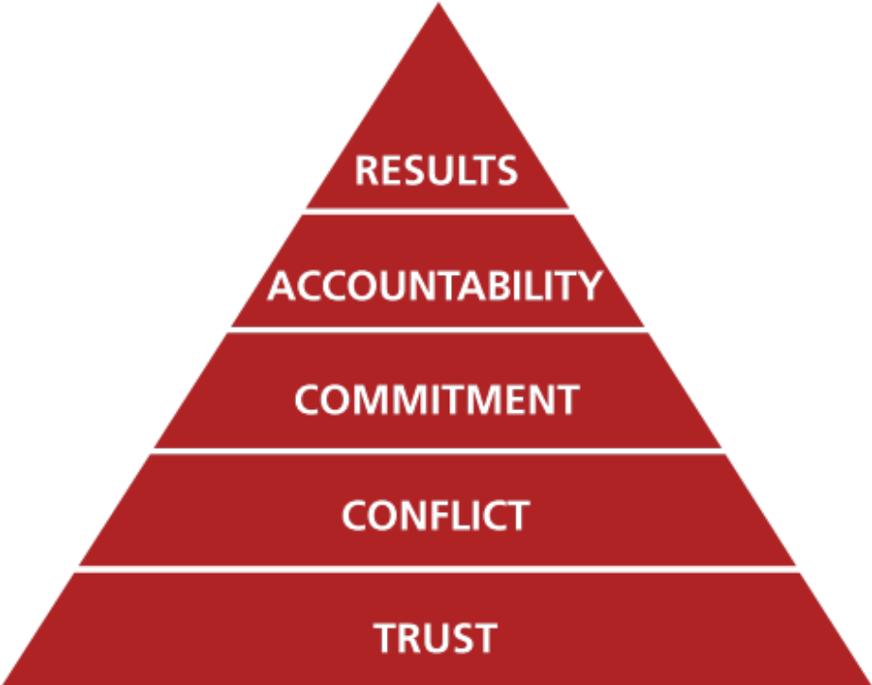
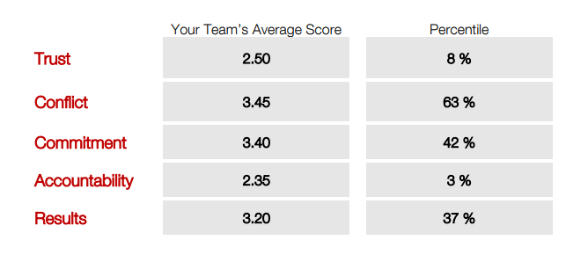
SAMPLE TEAM ANECDOTAL REPORT

Slide 20

MARSHMALLOW SPAGHETTI CHALLENGE
Each team receives:
20 pieces of spaghetti
1 marshmallow
1 roll string
1 roll masking tape
1 pair scissors
Instructions:
1. Build the tallest freestanding structure: The winning team is the one that has the tallest structure measured from the tabletop surface to the top of the marshmallow.
2. The entire marshmallow must be on top: The entire marshmallow needs to be on the top of the structure. Cutting or eating part of the marshmallow disqualifies the team.
3. Use as much or as little of the materials provided: The team can use as many or as few of the 20 spaghetti sticks, as much or as little of the string or tape, but they may not use any additional materials.
4. Teams may break up the spaghetti, string or tape: Teams are free to break the spaghetti and cut up the tape and string to create new structures.
5. Teams cannot hold on to the structure when the time runs out. Those teams touching or supporting the structure at the end of the exercise will be disqualified.

Slide 21

MARSHMALLOW CHALLENGE
What was the hardest part of this challenge? Easiest?
Did everyone engage in the challenge?
What did this activity show you about how you work in a group?
How will this help you be a better team member?
What would they recommend to others trying the challenge?

Slide 22
GOALS
Learn about The Five Behaviors of a Cohesive Team
Trust One Another
When team members are genuinely transparent and hones with one another, they are able to build vulnerability-based trust
Engage in Conflict Around Ideas
When there is trust, team members are able to engage in unfiltered constructive debate of ideas
Commit to Decisions
When team members are able to offer opinions and debate ideas, they will be more likely to commit to decisions
Hold One Another Accountable
When everyone is committed to a clear plan of action, they will be willing to hold one another accountable
Focus on Achieving Collative Results
The ultimate goal of building greater trust, healthy conflict, commitment, and accountability is one thing: the achievement of results

Slide 23

WHY ARE WE HERE?
Cohesive teams…
Make better, faster decisions
Tap into skills and opinions of all members
Avoid wasting time and energy on politics, confusion, and destructive conflict
Create a competitive advantage
Are more fun to be on!

Slide 24
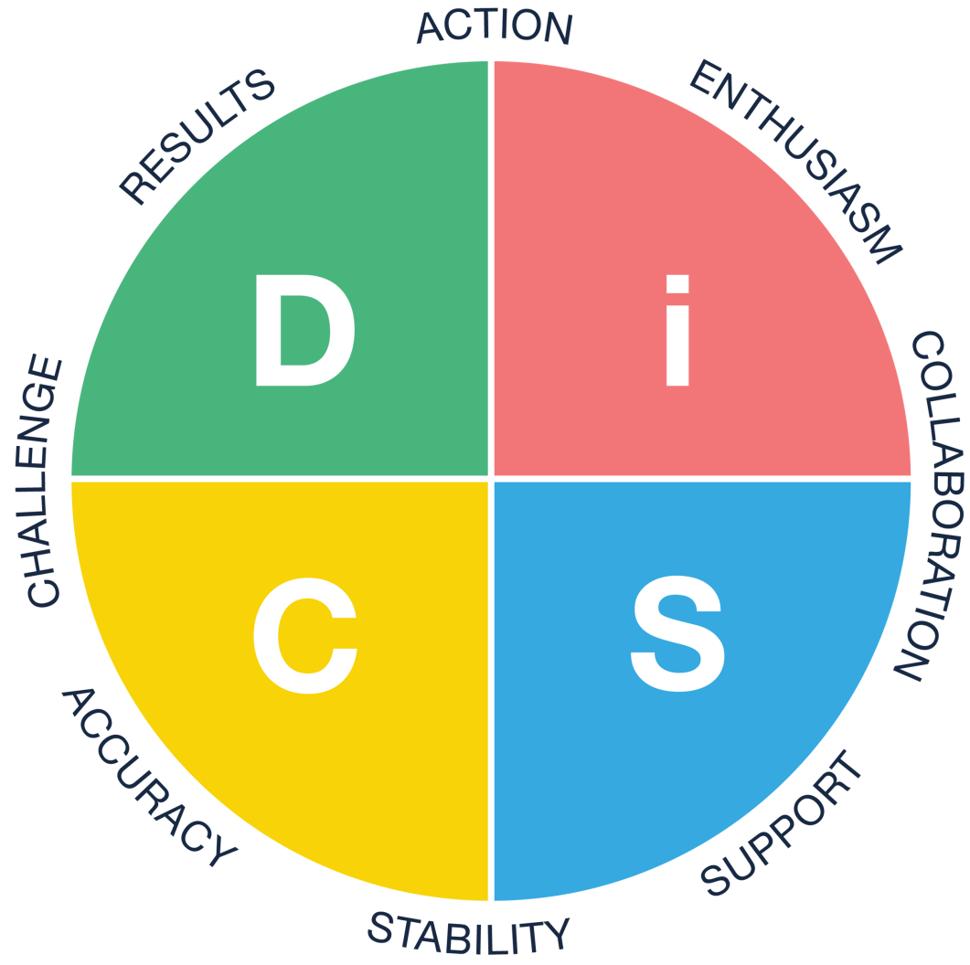
THE DiSC MODEL
Understand your behavioral tendencies and develop an understanding of how your behavior affects others
Respect, appreciate, understand, and value individual differences
Enhance strategies for working together to increase productivity
Plan for using DiSC information for continued growth and improvement

Slide 25
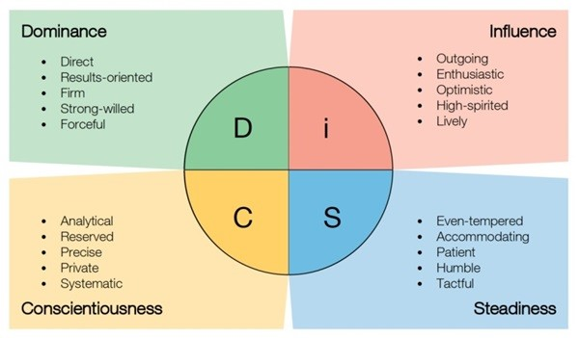
THE DiSC MODEL
POPULATION BREAKDOWN
D - 19% i – 32% S – 35% C – 14%

Slide 26
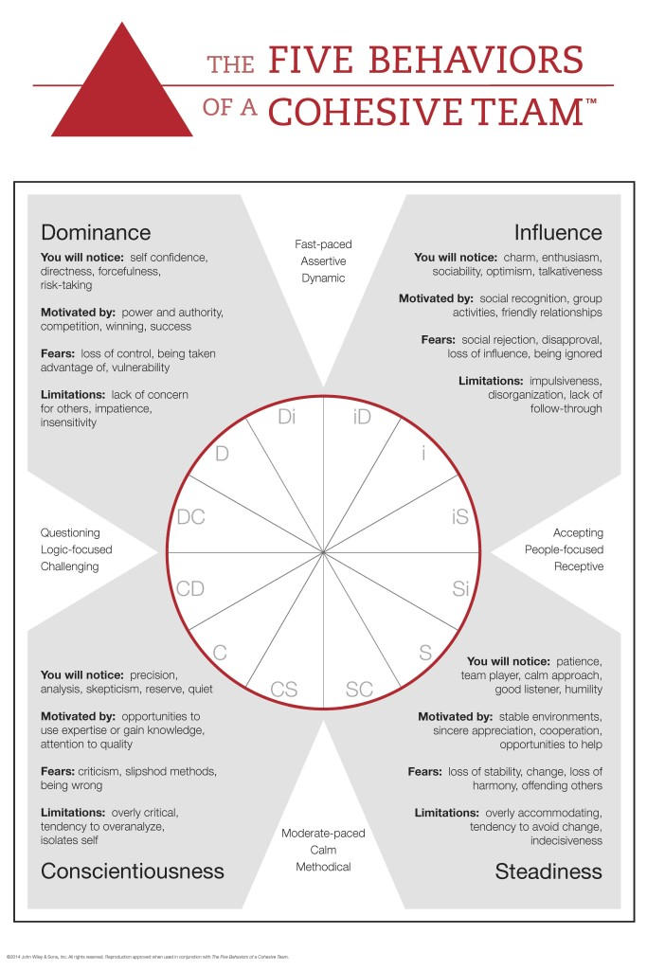
THE FIVE BEHAVIORS

Slide 27

TABLE TALK
SOME QUESTIONS:
1. Have you ever been on a team that worked well?
What made it work so well?
2. Have you ever been on a team that did not work so well?
What caused the problems?
3. As a leader, how can you build an atmosphere of trust?
4. As a leader, how can you help the group hold itself accountable – how can you build an atmosphere of “mutual accountability?”
5. How can you be a team leader and a team member at the same time?

Slide 28
TRUST: SURVEY ANSWER
When coworkers admit their mistakes, does it make you trust them more?
84% said yes

Slide 29

TRUST
Confidence among team members that their peers’ intentions are good, and that there is no reason to be protective or careful around the group.
When team members are genuinely transparent and honest with one another, they are able to build vulnerability-based trust.
Notes:
[DEFINE TRUST }
The first and foundational behavior of cohesive teams is trust. That means:
Being vulnerable with one other.
It’s about genuinely transparent and honest with one another so you can admit your mistakes, weaknesses
and say things like able to say things like “hey, I need help” or “I struggle in this are, or I’m sorry

Slide 30
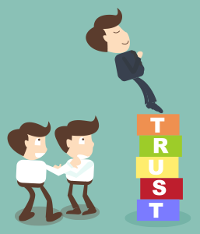
TRUST
TEAMS THAT TRUST
Admit mistakes, recognize weaknesses, and ask for help, and take risks
Appreciate and use one another’s skills and experiences
Accept questions and input about their areas of responsibility
Give one another the benefit of the doubt
Focus time and energy on important issues, not politics
Offer and accept apologies without hesitation
Look forward to meetings and other opportunities to work as a group

Slide 31
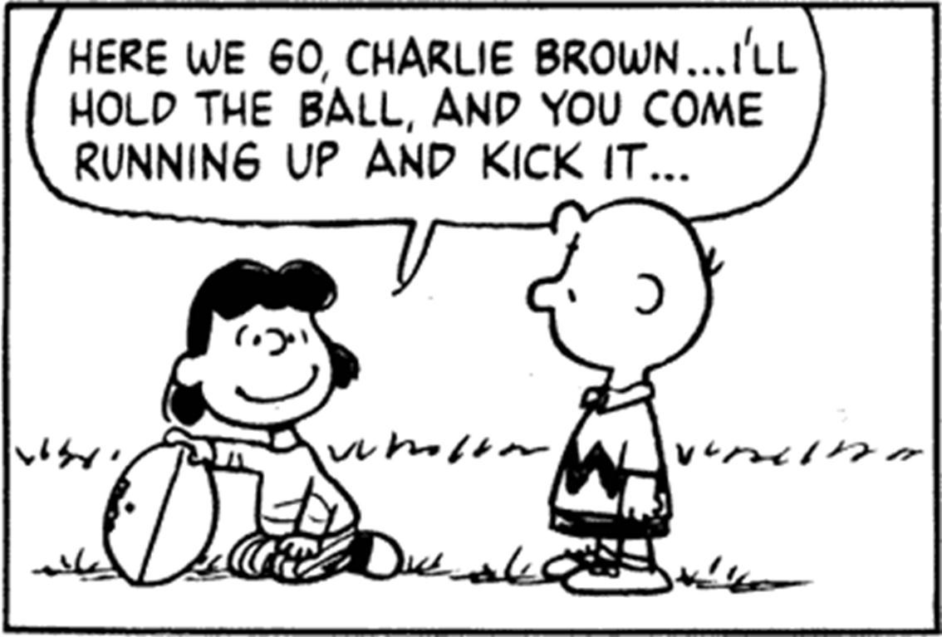

TRUST
TEAMS WITH A LACK OF TRUST
Conceal their weaknesses and mistakes and manage their behaviors for effect
Hesitate to provide feedback, ask for or offer help outside their own areas of responsibility
Jump to conclusions about others without attempting to clarify them
Fail to recognize other’s skills and experiences and hold grudges
Avoid meetings and spending time together

Slide 32

TRUST
THE LEADER’S ROLE IN BUILDING TRUST
TOOLS
Personal Histories
Team Effectiveness Exercises
Personality / Behavioral Preference Profiles
360-degree feedback
Experimental Team Exercises
ACTIONS
Lead by example
Protect the team by accepting responsibility for team’s mistakes
Focus on long term success
Quickly resolve problems

Slide 33

TRUST
SUGGESTIONS FOR OVERCOMING LACK OF TRUST
Personal histories exercise
Team effectiveness exercise -- team members identify the single most important contribution that each of their peers makes to the team, as well as one area that they must either improve upon or eliminate for the good of the team
Personality and behavioral preference tools (e.g., DISC)
Everything DISC 363 or other 360-degree feedback -- (separated from compensation and formal performance evaluation)
Experiential team exercises – building cars, paint ball, etc
The role of the leader: demonstrate vulnerability first; genuine, not staged.

Slide 34

CONFLICT
When there is trust, team members are able to engage in unfiltered, constructive debate.
Healthy conflict focuses on concepts and ideas to produce the best possible solution.
“You go to a meeting and you can disagree all you want, but at the end of that meeting you will commit and walk out of the room on the same page.”
Patrick Lencioni

Slide 35
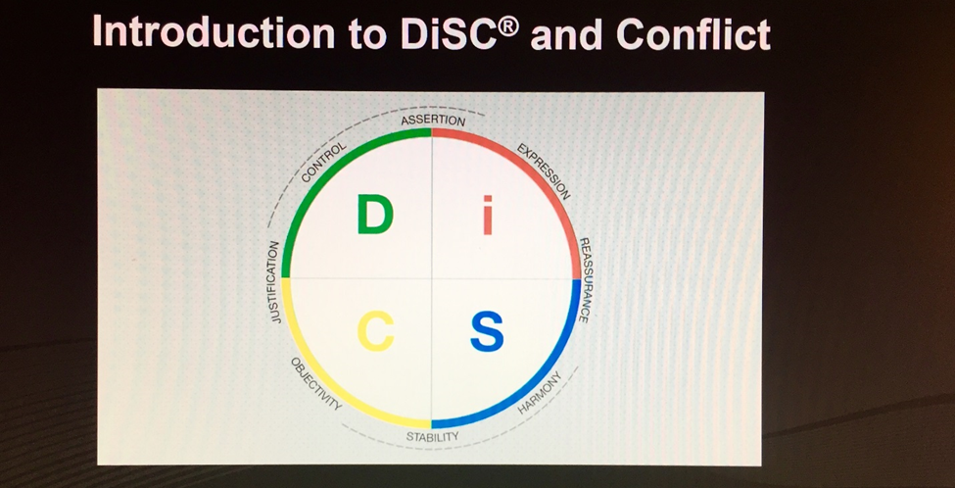
CONFLICT

Slide 36
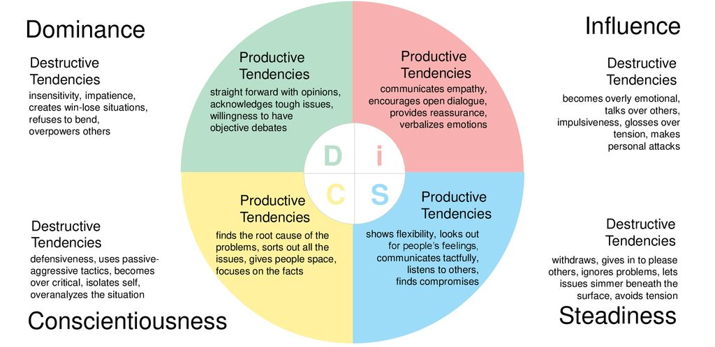
BEHAVIORS IN DiSC CONFLICT

Slide 37
CONFLICT: SURVEY ANSWER
Do you think your workplace would be more effective if people were more frank with their opinions?
71% said yes

Slide 38
CONFLICT
Destructive Responses

Slide 39
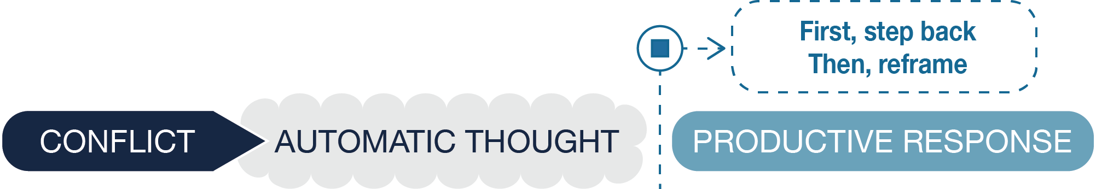
CONFLICT
Changing Your Response

Slide 40
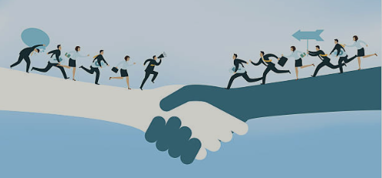
CONFLICT
TEAMS THAT EMBRACE CONFLICT
Have lively, interesting meetings
Extract and exploit the ideas of all team members
Solve real problems quickly
Minimize politics
Put critical options on the table for discussion

Slide 41
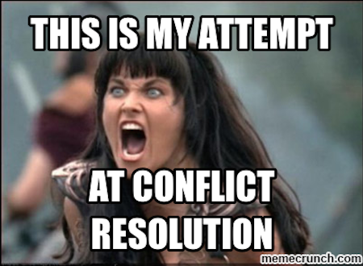
CONFLICT
TEAMS WITH A FEAR OF CONFLICT
Have boring meetings
Create environments where back-channel politics and personal attacks thrive
Ignore controversial topics that are critical to team success
Fail to tap into all opinions and perspectives of team members
Waste time and energy on posturing and interpersonal risk management

Slide 42

CONFLICT
THE LEADER’S ROLE IN EMBRACING
Tools
Disagreement “Root Causing”
Courage and Confidence
Personality / Behavioral Preference Profiles
Actions
Admit that it is ok to have conflict around ideas
Allow conflict resolution to occur naturally as often as possible
During conflicts, remind team that it is healthy and necessary
Protect team members from harm, by maintaining focus on ideas
Engage in healthy conflict, when necessary, as an example

Slide 43
CONFLICT
SUGGESTIONS FOR OVERCOMING FEAR OF CONFLICT
Acknowledge that conflict is productive.
Mining – extract disagreements, call out sensitive issues…
Real-time permission – openly state, in the heat of the moment, that this conflict is productive;
“it is ok, even good, for us to have this conflict…
The role of the leader: practice restraint; allow conflict, and resolution, to occur naturally.
(Do not let the {natural} desire to protect members from harm to prematurely interrupt disagreements).

Slide 44

COMMITMENT
When team members are able to offer opinions and debate ideas, they will be more likely to commit to decisions.
It’s not necessary to achieve consensus, but clarity and buy-in are key to commitment.

Slide 45
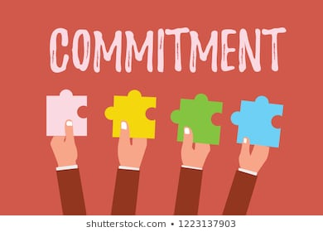
COMMITMENT
COMMITTED TEAMS
Change direction without hesitation or guilt
Create clarity, direction, and priorities
Align around common objectives
Develop an ability to learn from mistakes
Take advantage of opportunities before competitors
Move forward without hesitation

Slide 46
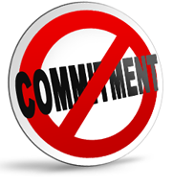
COMMITMENT
TEAMS WITH A LACK OF COMMITMENT
Create ambiguity about direction and priorities
Watch windows of opportunity close due to excessive analysis and second-guessing
Breed lack of confidence and fear of failure
Revisit discussions and decisions again and again
“Even cynics understand that groups of people willing to
put their individual interests aside for the good of the team
will outperform those who do not.”
Patrick Lencioni

Slide 47
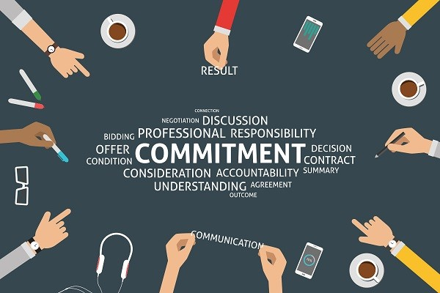
COMMITMENT
THE LEADER’S ROLE IN GENERATING COMMITMENT
Tools
Delegation in Low-Risk Situations
Consistent Messaging
Contingency and Worst-Case Scenario Analysis
Visual management
Actions
Set clear deadlines
Push group for closure of issues
Adhere to accepted schedules
Create certainty through commitment to actions

Slide 48
COMMITMENT
SUGGESTIONS FOR OVERCOMING LACK OF COMMITMENT
Recognize the dangers inherent within the desire for consensus and certainty
Cascading messaging – leave meetings clearly aligned with one another
Deadlines – make clear deadlines for when decisions will be made and honor those deadlines with discipline and rigidity
Contingency and worst-case scenario analysis
Low risk exposure therapy – demonstrate decisiveness in relatively low-risk situations
The role of the leader: the leader must be comfortable with the prospect of making a decision that
ultimately turns out to be wrong. And the leader must be constantly pushing the group for closure around
issues, as well as adherence to schedules that the team has set. What the leader cannot do is place too
high a premium on certainty or consensus.

Slide 49
COMMITMENT: SURVEY ANSWER
Do you sometimes feel that team projects suffer because people aren’t committed enough?
86% said yes

Slide 50
ACTIVITY: CLARITY AND BUY-IN TEACH BACK
Commitment with Clarity
How does clarity (or lack of clarity) affect our team?
Provide an example of a time when the team had clarity or lacked clarity.
How do the different DiSC® styles respond to a lack of clarity?
Commitment with Buy-in
How effective is this team at gaining buy-in for decisions?
How strongly does this team value achieving consensus?
How do the different DiSC® styles approach buying-in?

Slide 51
COMMITMENT: PERSONAL COMMITMENT
What will you as an individual do to help the team achieve either greater clarity or buy-in?

Slide 52

ACCOUNTABILITY
When everyone is committed to a clear plan of action, they are better able to hold one another accountable.
Team members must be willing to call one another on behavior or performance that isn’t up to agreed-on standards or that hurts the team.

Slide 53
ACCOUNTABILITY: SURVEY ANSWER
Would your work team be more effective if people were better at holding one another accountable?
89% said yes

Slide 54
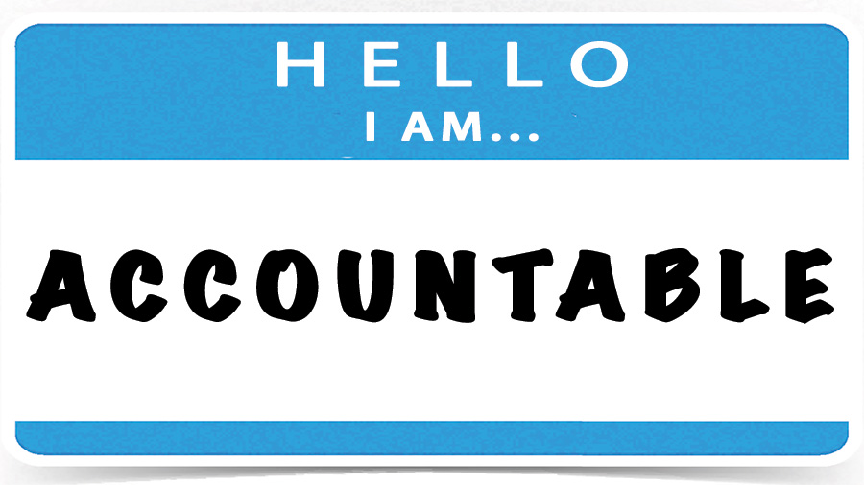
ACCOUNTABILITY
ACCOUNTABLE TEAMS
Ensure that poor performers feel pressure to improve
Identify potential problems quickly by questioning approaches without hesitation
Establish respect among team members who are held to the same high standards
Avoid excessive bureaucracy around performance management and corrective action

Slide 55
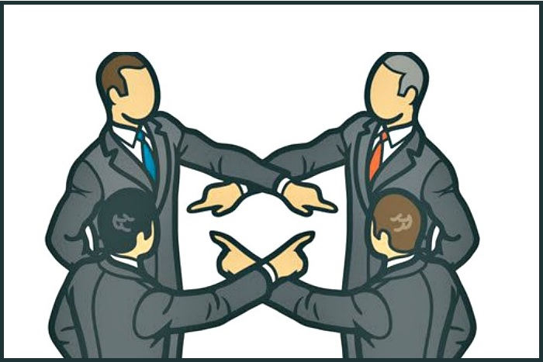
ACCOUNTABILITY
TEAMS THAT AVOID ACCOUNTABILITY
Create resentment among team members who have high standards of performance
Encourage mediocrity
Miss deadlines and key deliverables
Place burden on leaders to be the sole source of discipline

Slide 56
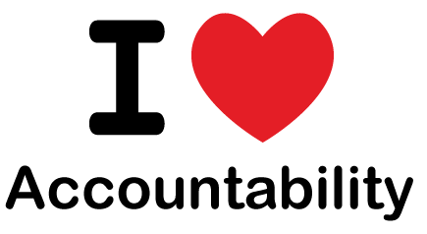
ACCOUNTABILITY
THE LEADER’S ROLE IN GENERATING ACCOUNTABILITY
Tools
Public goals and standards
Simple and regular progress reviews
Team-based recognition
Actions
Encourage and allow team to serve as the first and primary accountability mechanism
Serve as the ultimate arbiter of discipline when the team fails

Slide 57
ACCOUNTABILITY
SUGGESTIONS FOR OVERCOMING AN AVOIDANCE OF ACCOUNTABILITY
Accountability refers specifically to the willingness of team members to call their peers on performance or
behaviors that might hurt the team
Publication of goals and standards – the enemy of accountability is ambiguity
Simple and regular progress reviews
Team rewards
The role of the leader: to encourage and allow the team to serve as the first and primary accountability
mechanism. (Sometimes strong leaders naturally create an accountability vacuum within the team, leaving
themselves as the only source of discipline)

Slide 58
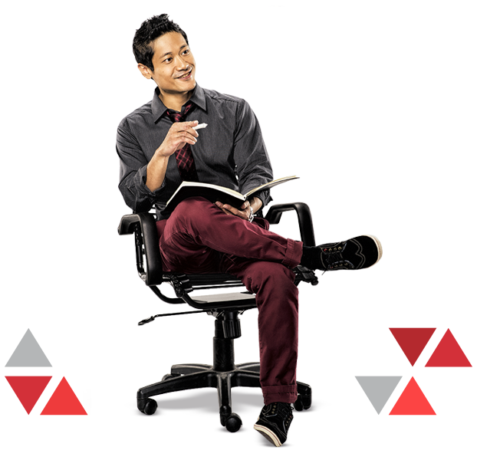
RESULTS
The ultimate goal of building greater trust, healthy conflict, commitment, and accountability is the achievement of results.
Team members need to make collective results their top priority.

Slide 59
RESULTS
In your work experience, have you seen projects suffer because people put their own needs ahead of the team’s needs?
87% said yes
5

Slide 60

RESULTS
TEAMS THAT FOCUS ON RESULTS
Minimize individualistic behavior
Retain achievement-oriented employees
Enjoy success and suffer failure acutely
Benefit from individuals who subjugate their own goals/interests for the good of the team
Avoid distractions
5

Slide 61

RESULTS
TEAMS WITHOUT A FOCUS ON RESULTS
Stagnate and fail to grow
Rarely defeat competitors
Lose achievement-oriented employees
Encourage mediocrity
Encourage team members to focus on their own careers and individual goals
Are easily distracted

Slide 62

RESULTS
THE LEADER’S ROLE IN FOCUSING ON RESULTS
Tools
Public Declaration of Results
Results-based Rewards
Actions
Set the tone for a focus on results by focusing on results
Must be selfless and objective
5

Slide 63

FOCUSING ON COLLECTIVE RESULTS
FOUR COMMON DISTRACTIONS
Ego
Career Development
Money
My Department
ACTIVITY:
Work in small groups to come up with strategies for keeping focused on collective results and then ask each group.

Slide 64
RESULTS
SUGGESTIONS FOR OVERCOMING INATTENTION TO RESULTS
Team status – plenty of teams fall prey to the lure of status.
Individual status – the familiar tendency of people to focus on enhancing their own positions or career
prospects at the expense of the team.
Recognize that many teams are simply not results focused – they do not live and breathe in order to
achieve meaningful objectives, but rather merely to exist or survive.
Public declaration of results – teams that are willing to commit publicly to specific results are more likely to
work with a passionate, even desperate desire to achieve those results.
Results based rewards – letting someone take home a bonus merely for “trying hard” sends a
message that achieving the outcome may not be terribly important after all.
The role of the leader: perhaps more than any of the other dysfunctions, the leader must set
the tone for a focus on results. If team members sense that the leader values anything other than results,
they will take it as permission to do the same for themselves.

Slide 65
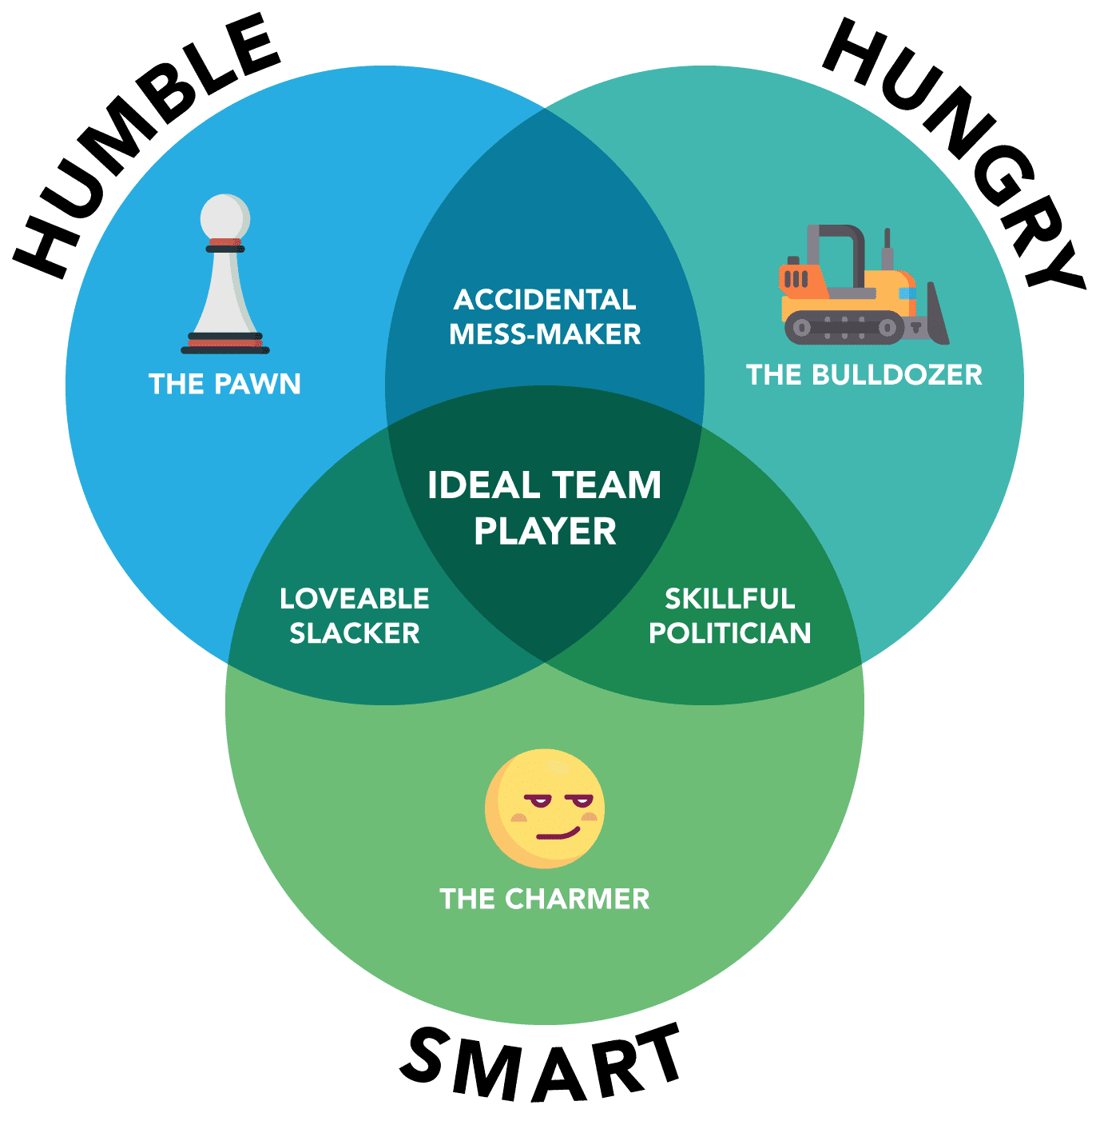
THE IDEAL TEAM PLAYER
Humble, Hungry and Smart—The Three Virtues Combined What makes humble, hungry and smart powerful and unique is not the individual attributes themselves, but rather the required combination of all three. If even one is missing in a team member, teamwork becomes significantly more difficult, and sometimes not possible.
HUMBLE
Ideal team players are humble. They lack excessive ego or concerns about status. Humble people are quick to point out the contributions of others and slow to seek attention for their own. They share credit, emphasize team over self and define success collectively rather than individually.
HUNGRY
Ideal team players are hungry. They are always looking for more. More things to do. More to learn. More responsibility to take on. Hungry people almost never have to be pushed by a manager to work harder because they are self-motivated and diligent. They are constantly thinking about the next step and the next opportunity.
SMART
Ideal team players are smart. They have common sense about people. Smart people tend to know what is happening in a group situation and how to deal with others in the most effective way. They have good judgment and intuition around the subtleties of group dynamics and the impact of their words and actions.

Slide 66
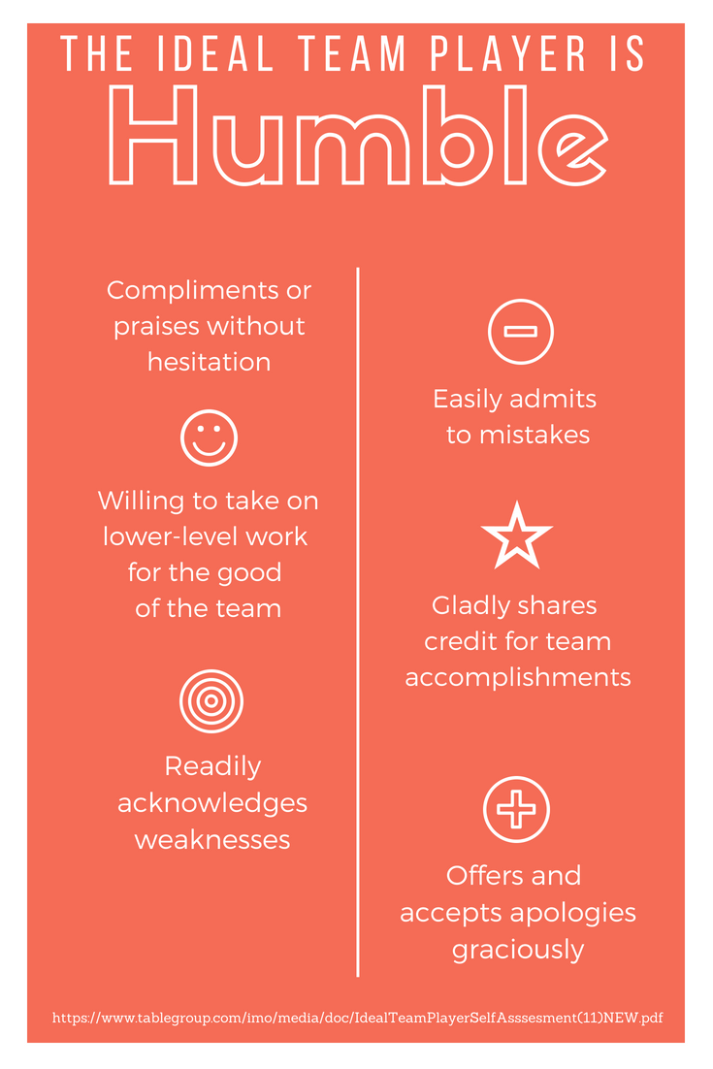
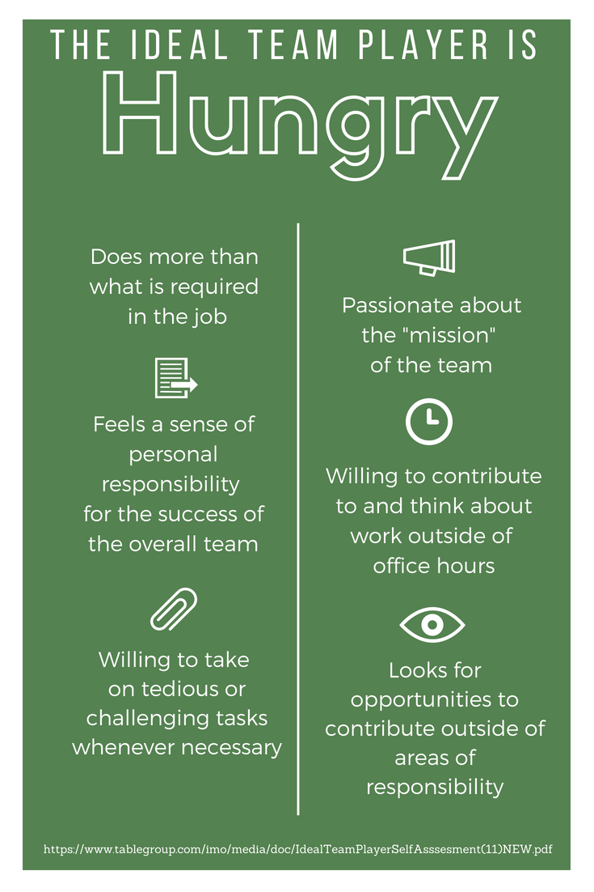
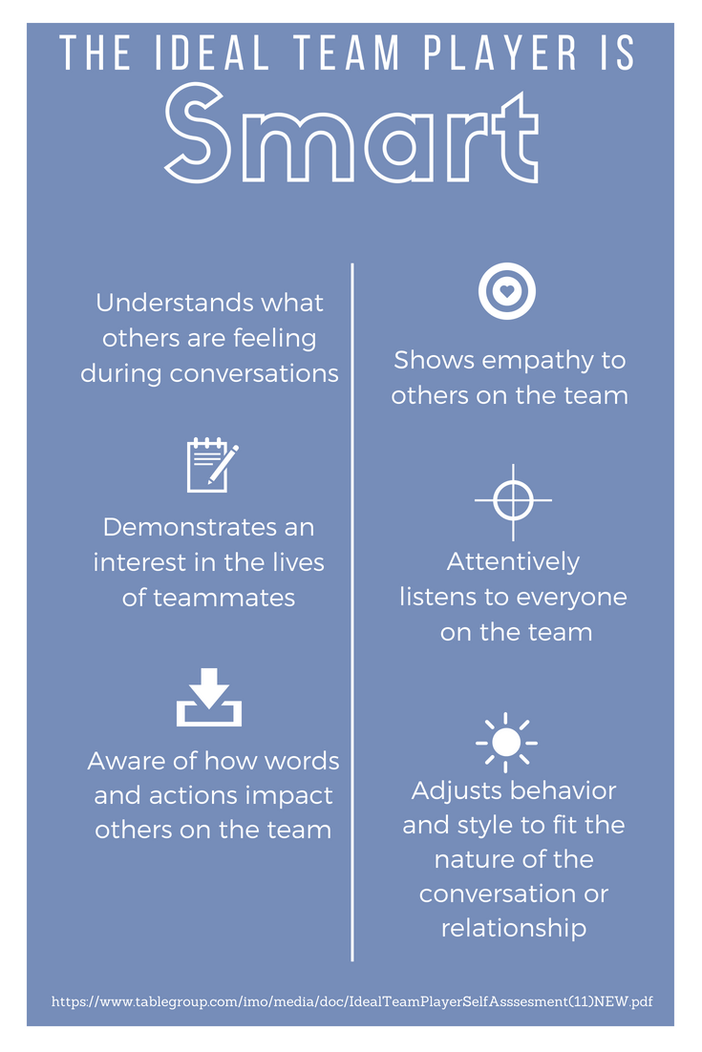
TIPS TO BECOME THE IDEAL TEAM PLAYER

Slide 67
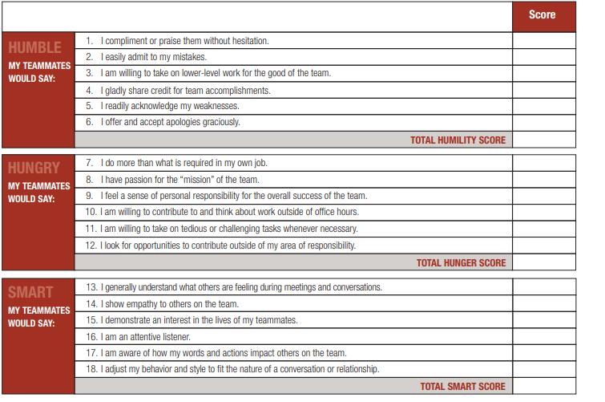
SELF-ASSESSMENT
Instructions: Use the scale below to indicate how each statement applies to your actions on the team. Respond as honestly as possible as this will allow you to most accurately identify any ideas of development that you may have.
Scale: 3 – Usually, 2 – Sometimes, 1 – Rarely

Slide 68
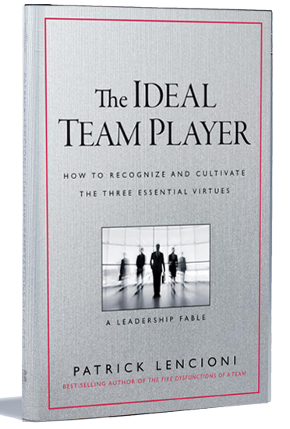
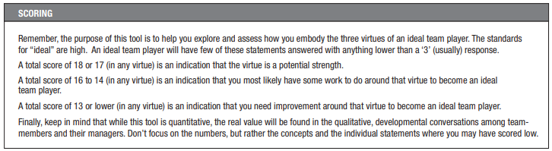
SELF-ASSESSMENT SCORING

Slide 69
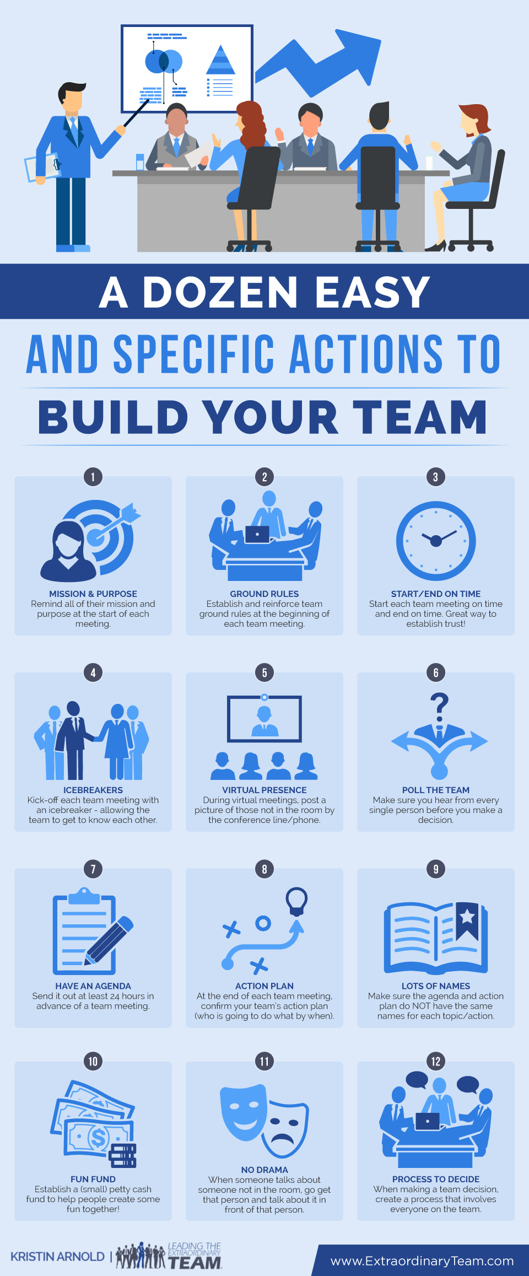
TIPS TO BUILDING THE BEST TEAM

Slide 70



WHAT IS YOUR SENTENCE?
Daniel Pink, in his bestseller DRIVE, tells a story about Clare Booth Luce, who was a writer and one of the first woman to serve in the US Congress. In 1962 she had a meeting with JFK. At the time, JFK was doing a thousand things at home and abroad, and Luce was concerned that his presidency was becoming muddled paragraph.
She told him: “A great man is one sentence.” We believe a great organization is also one sentence.
Like President Lincoln: “He preserved the union and freed the slaves.”
Like FDR: “He lifted us out of a great depression and helped us win a world war.”
So the question she posed to JFK was this: What was to be his sentence?
Activity: Think about and then write down your sentence and one for your organization. In other words, what is the short, one sentence version of how you want to be remembered and how you want your organization remembered. Asking yourself and your team this will help direct you toward a path which will be successful and fulfilling. Asking employees this question will help you assist them to be in the right seat on your bus..

Slide 71

FINAL THOUGHTS
SOME OBSERVATIONS :
Team success requires great and lasting trust.
2. Trust enables success at dealing with conflict in a way that does not “break” the team.
3. Trust leads to mutual commitment.
4. Trust leads to genuine accountability.
5. For all of this to happen, the leader is critical – truly important.
Every team has to have a very good leader.

Slide 72
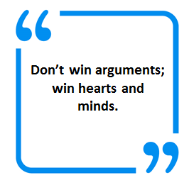
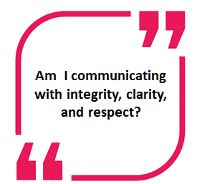
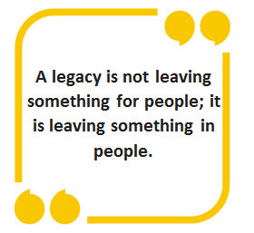
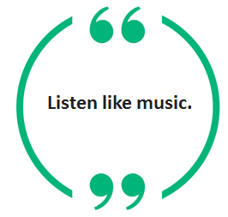
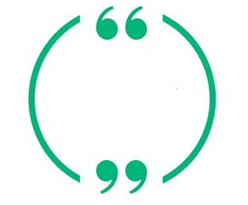
FINAL THOUGHTS
Think results, relationships, and reputation in every interaction. How can I build relationships and results in this team?
Don’t win arguments;
win hearts and minds.

Slide 73
RALLY YOUR TEAM
6 STEPS TO RALLY YOUR TEAM AROUND A COMMON DREAM
Include everyone.
When you articulate a purpose, be inclusive of employees, customers, investors and other communities touched by your organization's vision and objectives. Find a goal that all stakeholders can root for.
Make it real.
Don't rely on jargon-leaden mission statements no matter how lofty and inspiring they might sound. They too often create cynicism. Include the entire team when creating a document or policy that leads to a specific outcome and eschews corporate-speak.
Celebrate heroes.
Collect stories of team-members who go the extra mile for customers or colleagues. These examples honor those who do exceptional work advancing the company's goals and illustrate your organization's vision in action. They also are tangible reminders of why your team and its values are different from your competitors.
Renew the vision.
Don't be afraid to replace an aging, stale or blurred vision. As organizations grow, early passions die, and bureaucracy often comes alive. Team members may sense this drift and arrive at work unclear about their goals or the purpose of the enterprise.
Think big, but keep it simple.
Pick an outcome team members will be proud to pursue -- nothing vague or defensive, either--and keep these goals to no more than three. Be the evangelist and guardian of these aims.
Sacrifice.
Big dreams, whether in relationships or organizations, almost always require sacrifice at some level, and that's good. People tend to love those things for which they have sacrificed. Just make sure the leaders are making a sacrifice, too.

Slide 74

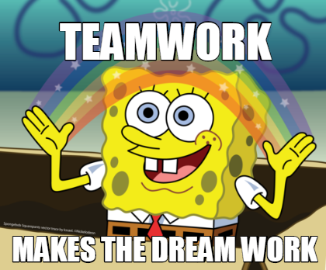
12 WAYS TO IMPROVE WORKPLACE TEAMWORK

Slide 75
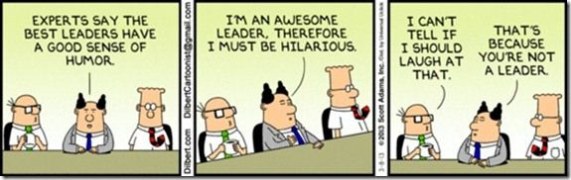
THE ROLE OF LEADERS
1
Leaders Embody the Change They Want to See: Leaders have a responsibility to demonstrate the beliefs of the company and reinforce behaviors that reflect those values.
Leaders Care About Employee Well-Being: While maintaining a professional persona matters, an employee's well-being directly impacts how they perform and engage at work.
The Leader Drives a Thirst for Continuous Learning: No matter if entry-level or senior-level, all employees have something to teach one another. Leaders hold in-depth knowledge of how the engine of their company works, learning about each employee as more than a cog in the machine.
The Leader Focuses on Social Good for Employees and Clients: The best business strategies consider the needs of each client from various points of view and ensure your employees are on board to follow the client journey.

Slide 76
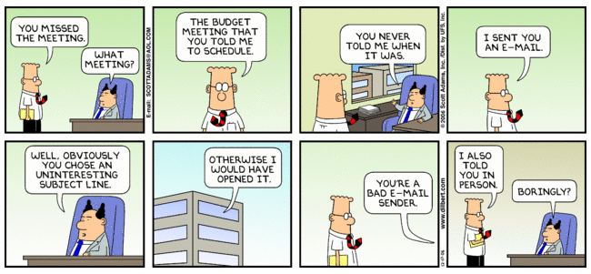
COMMUNICATE, EVERY DAY, EVERY WAY
2
Be clear: Set the tone for communication among the team. When is it acceptable to close your office door? Is it okay to contact someone after hours? How often should the whole team get together? This outline will help to keep everyone on the same page and communication flowing.
Listen: Communication is as much about listening as it is about speaking. Make sure you’re listening to fellow team members and actually considering their thoughts before offering your own solutions and input.
Method: There are so many ways to reach each other in the modern age. Try to use the most suitable tool to communicate for your specific needs, whether that’s email, a chat tool, phone call, or face to face.
Touch base: Encourage informal meetings, information sharing, and huddles between team members. People shouldn’t have to wait for a weekly catch-up meeting to get together. Collaborative team members are comfortable communicating as and when they need to.

Slide 77
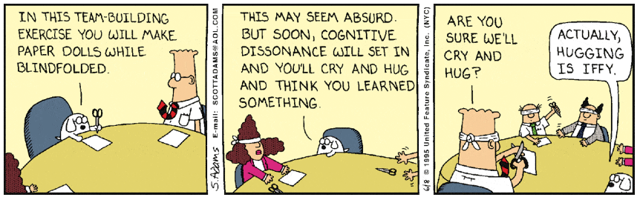
EXERCISE TOGETHER
3
Team building exercises: They can be short and sweet tasks that take less than 10 minutes (and it may even be better that way). Team building exercises are like physical exercise - if you do it often, the benefits are more long-lasting. You can’t summit Everest if you train twice a year.
Before deciding on a team building exercise: Asses what specific challenges your team is facing. For example, does your team need to become more familiar with each other, or do they need to recover from a conflict? You may pick different exercises for each of these situations.

Slide 78

ESTABLISH TEAM RULES
4
Rules: Rules will safeguard the success and productivity of a team. You should be clear on why they exist and ask for contributions/feedback from everyone.
Some examples:
  When we meet, we’re all present (no cell phones or laptops).
  We’ll be open about our frustrations.
  We listen with intent, rather than waiting for our turn to talk.
  We respect out of office hours and won’t expect communication unless it’s an emergency.

Slide 79

CLARIFY PURPOSE
5
Clarity: Be clear about why you’re doing what you’re doing - it’s the key to motivation. Not only will this keep everyone motivated and aligned, it’s a great way to review your process and ensure you’re taking the best steps to get to where you need to be.
Ways employees want to be recognized and rewarded:
  Company or team-wide emails recognizing individuals/teams
  In-person recognition and thanks
  Promotions
  Bonuses
  Extra vacation days

Slide 80

RECOGNIZE AND REWARD
6
Recognition is key: Recognized employees are satisfied employees, and satisfied employees do better at work.
Ways employees want to be recognized and rewarded:
  Company or team-wide emails recognizing individuals/teams
  In-person recognition and thanks
  Promotions
  Bonuses
  Extra vacation days

Slide 81

OFFICE SPACE
7
Workspace: The needs of your teams should be reflected in your workspace. Look around your office and consider what could be done to encourage impromptu huddles for productive conversation, accessibility to knowledge experts, and semi-permanent spaces for group projects.

Slide 82

TAKE A BREAK
8
Take a break: Team building doesn’t have to happen while you’re actively working. In fact, it’s proven that taking breaks together can result in a higher level of productivity and help reevaluate goals as needed.
Informal breaks: One week, you could round up the team and grab a coffee together, or pick-up some sweet treats for your team on the way to work and gather for a morning chat. Getting together in a less formal setting will encourage better communication, sharing, and bonding between team members. If you want to start small, break up the day by stepping outside to have one of your team meetings on foot.

Slide 83

FOCUS ON STRENGTHS
9
Focusing on the weaknesses: Focusing on your team members weakness can seriously affect engagement and consequently lower the team’s productivity.
Everyone is different: We have different strengths, passions, and weaknesses. One of the cornerstones of a good team leader is focusing on individuals’ strengths and bringing together a team of people that has a combined skillset to get the job done.

Slide 84

SHOW GRATITUDE
10
Thank you: Showing gratitude can increase a person's wellness, increase better sleep habits, increase metabolism and lessen stress. This directly impacts work results and employee interaction. With employee appreciation, you're not only boosting performance and engagement, but the employee's well-being and health.
Start saying those magical words: Be thankful for the big and the small things that your colleagues bring to the table each day. (Don’t go overboard though. It’s important that your thanks are genuine and timely. Think quality, not quantity.)

Slide 85

ACCEPT DIFFERENCES
11
Differences of opinion: It can lead to frustration, disagreements, and sometimes even conflict. Conversely, they can also benefit a project or final product due to unique perspectives and influences. The difference is all in your approach.
To keep your team together (and stay sane) consider a few of these handy tips:
  Remember the importance of balance: Think of Bert and Ernie from Sesame Street. They’re best friends but polar opposites - one represents Chaos, the other represents Order.
  Embrace disagreements: These are often learning opportunities. Opposite opinions should be dealt with respectfully and carefully to ensure everyone is happy and innovation is maximized.
  Appreciate the differences: Both Bert and Ernie bring something to the table. One is smart and logical, the other is playful and fun. Even though your team members have different attributes, they should be recognized for the strengths they bring.

Slide 86

CELEBRATE
12
Celebrate: Like recognition and gratitude, celebrations don’t have to be big, but they should be frequent. By doing this, you’re weaving them into your team’s culture and the benefits will become lasting and more impactful.
Some ideas:
  Have a casual Friday meeting: Chat about the small successes of the week. Use a post-it board to capture the success and get everyone involved; people write their achievements on a sticky note and put it on the board, then explain it to the group.
  Get out of the office for lunch: This can be after work or during working hours (depending on your company culture). Be clear on the purpose of this celebration, if you reached a big milestone or your team received praise from senior leadership.
  Have a small token mascot: A magic eight ball, a pair of glitzy scissors, a plastic figurine - that gets passed to the team member who was most successful or helpful in the past month. Have every team member contribute to this decision through an anonymous vote.

Slide 87

NEXT STEP Commit to making cohesive teams YOUR competitive advantage!
Dorinda Byers
byers.18@osu.edu
Susan Foltz
susan.foltz@development.ohio.gov

Slide 88
Additions

Slide 89

WORKPLACE PREFERENCES OF THE FIVE GENERATIONS

Slide 90


GENERATIONS

Slide 91



GENERATIONS

Slide 92


GENERATIONS

Slide 93
Accountability
Gutter Ball or Pipeline
In this game, groups compete to get a marble from one side of a field or room to another in the shortest amount of time without letting it touch the floor. Divide your group into teams of four people and give each person a small section of pipe that has been cut in half and they must pass the marble from one to another without dropping it. If it falls, they must go all the way back to the starting line.
The person with the ball can slow it down by tilting it one way or the other before the next section of pipe gets in place, but this isn't easy, so it's important for another person to put their pipe in place as quickly as possible so it can be passed on. You can also make the game more challenging by adding in obstacles in the way of the group like "rivers" of paper that can't be stepped in or adding "mountains" like desks that must be crossed.
After the game is over, remind the team of the importance of stepping into the roles they are required to fill as quickly as possible as well as the importance of acting accountable rather than shifting blame when the ball falls so they can get back to work and try to get back on track as quickly as possible.

Slide 94
Conflict
​CODE OF CONDUCT FOR THE TEAM - TEAM NORMS:
What Is This? Why it works: This free team building activity is a list of behavior expectations for how the team will engage in discussion and debate. It is created by the team (this is why it works) and is visible and reviewed by all prior to all meetings.
This is so simple and so powerful. I use it in every development and facilitation meeting I hold. It helps the team stay on track and regulate their own behaviors. Here's the best way to help your team create their own Code of Conduct:
1. Ask each team member to write down their preferences for acceptable and unacceptable behaviors around discussions and debate. (ex: tone of voice, use of language, participation, etc.)
2. Hold a group discussion. Ask everyone to share their list. Capture the answers on a flip chart.
3. Discuss similarities, differences and priorities. Develop a list of no more than 8 items that represent the team's idea of productive discussions.

Slide 95
Results
The goal of this exercise is to help teams work towards a cohesive creative result.
Collect a variety of objects and put them in the center of the room on a table, so that it is visible to all the teams. These can be very different things and can be as varied as stationery, cake, toys, jewelry, umbrella and so on. Aim to gather around 25 different pieces.
Each group is given sheet of paper and pen. Next, they are instructed to classify the demonstrated things into 4 categories (you can decide on this number). Invite a spokesperson from each of the group to present how they classified things and the logic behind it (may be end-use, looks, some common traits, etc.) This gives a new out-of-the-box lens to view routine things in work and life.

